Slide 1

HEAR, HERE
We communicate with you
김현우 백승정 양채은 Rany Punreach

Slide 2
CONTENTS
01 Introduction
Motivation & Client’s Needs
Brief Explanation
02 Development Environment
03 Service Architecture
Overall Architecture
Recognition
Translation
04 User Cases
05 Future Plan

Slide 3
01
Introduction
Motivation & Client’s Needs
interpreting sign language in other languages
simple sign
language translation
Korean sign language translation service
scarcity and high cost of sign language translators
ASL-centric simple sign language translation service in market
not easy for deaf people in other languages to communicate
Sign Language Translation Application
for diverse sign language users
HEAR, HERE

Slide 4


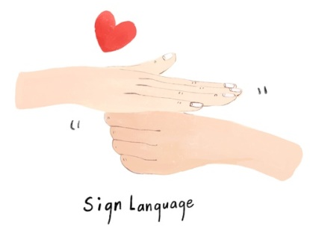

01
Introduction
Brief Explanation
1.
2.
3.
Recognized movements are translated into Korean sign language
English signers perform sign language actions
Our application camera recognizes motion

Slide 5
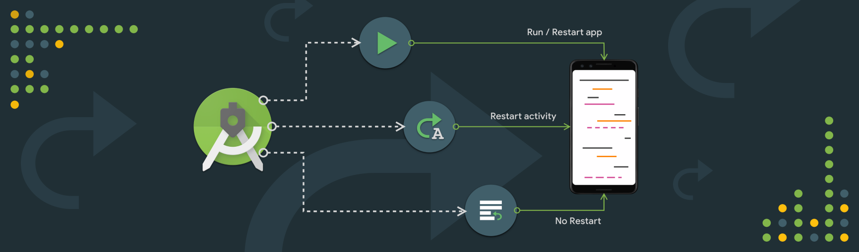






02
Development Environment
IDE
Programing Language
DB
Version Control
Android Studio
JAVA
Realm
Git Hub

Slide 6



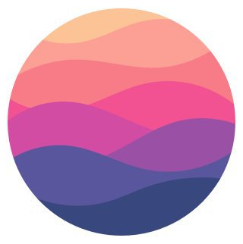
03
Service Architecture
Overall Architecture
HEAR, HERE
save, load users’ data
BACK END
Users
Android
Studio
recognition, translation
FRONT END
JAVA
openCV
Realm

Slide 7
03
Service Architecture
Recognition Methodology
[for Recognizing hand motion]
Skin Color Segmentation
Skin Color Segmentation on Static Image
Skin Color Segmentation in real-time
HSV color space model
RGB (Red, Green, Blue)
HSV (Hue, Saturation, Value)
CMY
XYZ
Color based image segmentation uses the color feature of every pixel to differentiate meaningful pixels in an image.
▶

Slide 8


03
Service Architecture
Recognition Methodology
OpenCV
• RGB to HSV conversion
• Dilation and Erosion
• Blurring
• Find Contours
• Forming Convex Hulls
Hand Segmentation using Java
• Skin Color Segmentation
• Background Subtraction
• Final Hand Segmentation Technique

Slide 9
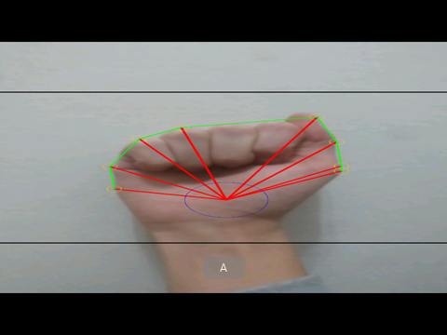
03
Service Architecture
Recognition
Extracting Contour
Information
Morphological Operations
using OpenCv functions to calculate the moments and centroid of the object (hand) and separate it from the background
Gesture Recognition
The program uses the lengths of the lines connecting the centroid and vertices of the convex hull to recognize gestures and distinguish it from other gestures

Slide 10
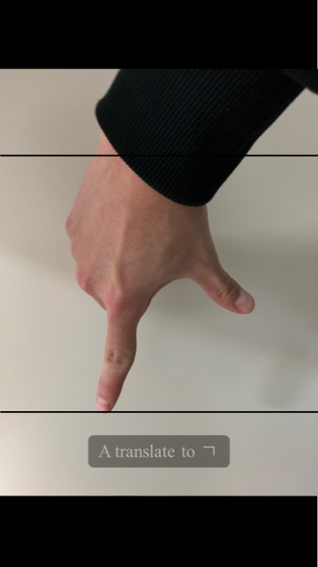
03
Service Architecture
Translation
FIRST
SECOND
THIRD
Each English character corresponding to a recognized English sign language is stored.
Find Korean words that correspond to English words.
Finds Korean sign language that responds to Korean words and prints them out.

Slide 11
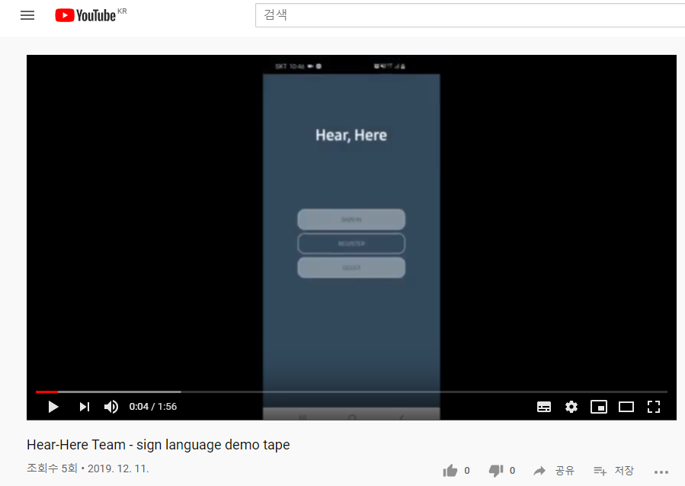
04
User Cases
Demo

Slide 12
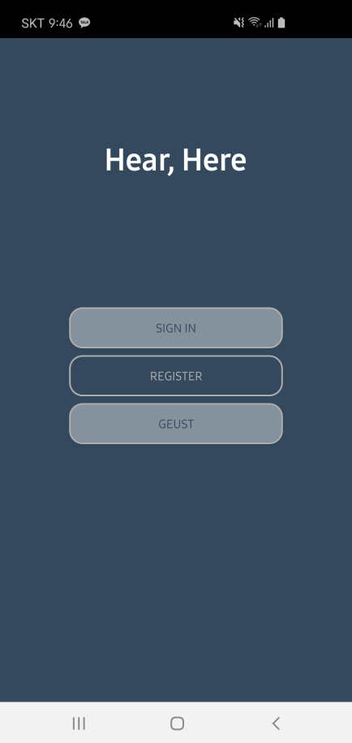
05
Future Plan
Recognizing Korean Sign Language
We will enable the recognition of vector values of Korean sign language movements to be translated into English sign language.
Recognizing and Printing Videos
We will make possible the translation of sign language words or sentences by the recognition of continuous motion.
Publishing
After completing the above functions, we will officially launch them on the market and receive feedback from users.

Slide 13
Thank You

